Slide 1
Quadratic optimization with quantum computing
Bálint Hantos
Supervisor: Péter Rakyta
Notes:
What I’m going to talk about today is the theoretical background of the properties of bosonic circuits and doing calculations with them.
The reason I chose this project is that quantum computers have the potential to revolutionize computation by making certain types of classical problems solvable.
While no quantum computer is sophisticated enough to do these calculations yet. But a great progress is under way.

Slide 2
Open questions
When will we be able to build a powerful optical quantum computer?
What physical resources and equipment will this device need?
How much do we have to improve technology to reach this?
Notes:
I’d like to begin with an open question that is:
When will we be able to build an optical quantum computer that can outperform any existing classical computer?
What physical resources and equipment (other than time and memory) will this device need?
How much do we have to improve our technology to reach this?
There was a tremendous effort made in this field. One of the results was a scheme that is quite promising, but it needs a tremendous amount of hardware:
we would need billions of linear optical elements and millions of single photon sources.
This begs the question: Is there any easier way to do this? Boson sampling answers that question.

Slide 3
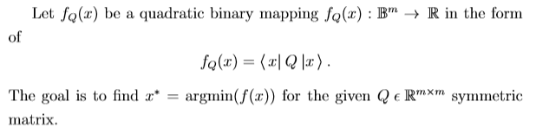
Application: Quadratic unconstrained binary optimization - QUBO
Closely related to the Ising model
Used in graph theory, finance, computer science

Slide 4
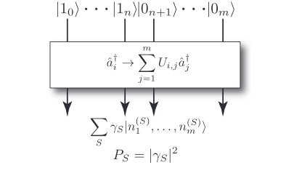
Boson sampling
Gard, Bryan T., et al. "An introduction to boson-sampling.„ 2016
Notes:
What is a boson sampler and how it works?
Here is what the boson sampler does on a diagram.
On top, there are single photon states and vacuum states, that are propagated through a linear optics network.
It implements a unitary map on the creation operators like this.
Then at the output we’ve got some big superpositions of the multiphoton optical states.
In this notation S represents a configuration of where the photons could arrive.
Gamma represents the amplitude associated with that configuration.
N sub 1 super S is the number of photons in the state 1 in the configuration S.
The output state represent all the possible configurations.
Then we measure the output and we get the S configuration with absolute gamma squared probability.
So the goal is to build up statistics of what P of S looks like.

Slide 5

Boson sampling
Relation to matrix permanents:
A – unitary of the linear optics network
Complex-valued permanent: #P problem
Boson sampling is classically inefficient
Gard, Bryan T., et al. "An introduction to boson-sampling.„ 2016
Notes:
Then the question is why do we need a quantum computer for that?
One of the key results is that measuring the probability of a given configuration is proportional to a permanent of the A matrix.
The A matrix is a unitary transformation describing the linear optics network and the output configuration.
It is a very hard problem to calculate complex-valued matrix permanents. So boson sampling is classically inefficient to simulate, we need a real quantum device to that.

Slide 6
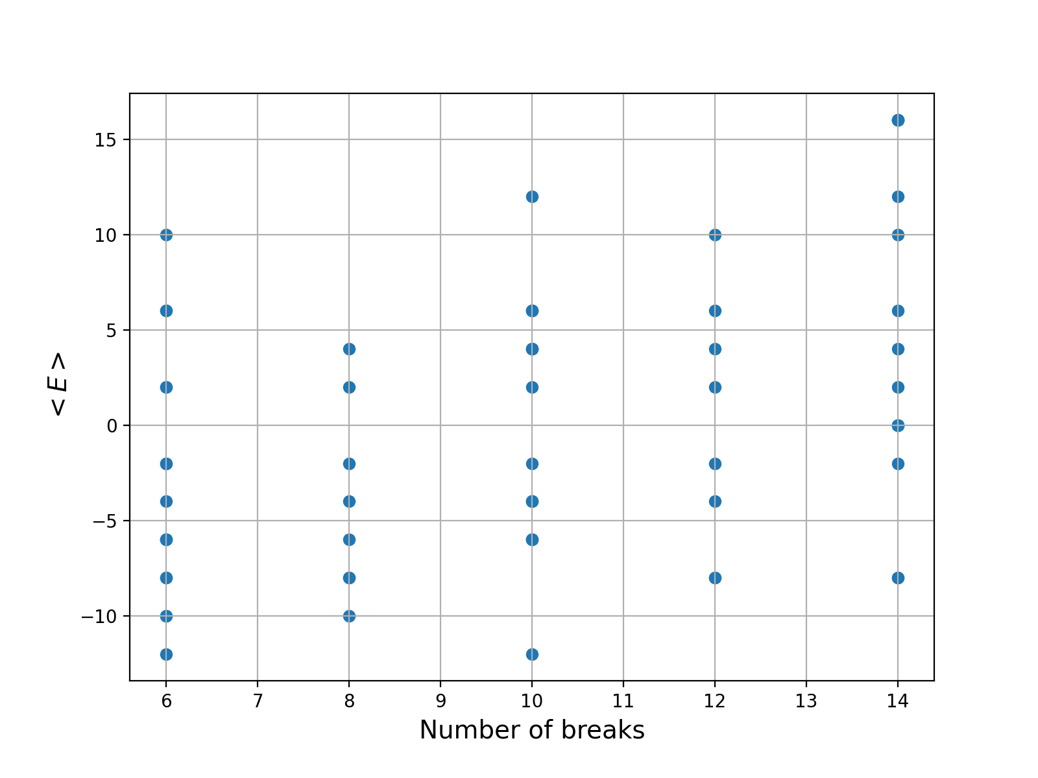
Energy and number of breaks

Slide 7
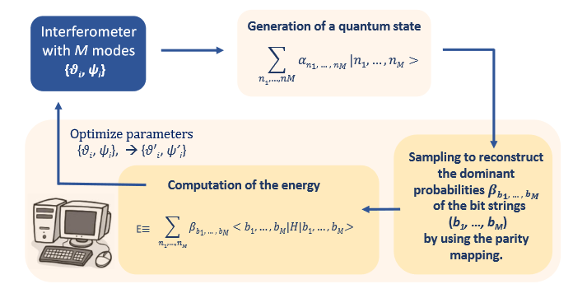
Model overview
Bradler, Kamil, and Hugo Wallner. "Certain properties and applications of shallow bosonic circuits.„ 2021
Notes:
This is the model overview of the variational bosonic solver.
In the first step we generate a quantum state with the M-mode interferometer.
The amplitudes of the quantum states depend on the circuit elements’ angles, thetas and psis.
Then we apply a parity function so that the we map the optical states to a many-qubit hilbert space. Then we have our qubits.
Note: Each qubit state has a some energy associated with it.
So we apply the parity functions and record the amplitudes of the qubits.
Then using these amplitudes and the qubit states we calculate the expected value of the energy – it is the objective function, that we try to minimize.
Then we tweak the psi and theta parameters with gradient descent and do the previous steps again.
The goal is to find the smallest energy and the associated bit string.
So, how can we use this ? We need to formulate our our problem as optimizing the energy by choosing an appropriate Hamiltonian matrix.

